Slide 1
Marathon Dashboard: A tool to assist athletes

Slide 2
BACKGROUND
The Boston Marathon is an annual marathon race hosted by several cities in greater Boston since 1897. Athletes training for a marathon want to compare their performance against other runners.
Are they competitive with other runners?
What is their projected rank in a future marathon?
For novice runners, what might their 40 km run time be given run times of shorter distances?
Are they expected to be faster in the 1st half or the last?
Are they handling fatigue well?

Slide 3
EXAMPLE USE CASE
User is a novice runner who tracks run times as she increases her distance towards 40 km.
Runner provides certain characteristics
Age, gender, run times by distance, and weather information
A dashboard compares the runner’s metric against athletes who ran in historical Boston marathon data
A predictive model can return an expected 40 km run time, the expected overall and demography-based rank

Slide 4
DASHBOARD PACKAGES IN PYTHON
Two commonly used Python packages for dashboards are Bokeh and Dash.
Dash
Built on top of Flask, Plotly.js, React, and React Js
Only Python knowledge needed
Available since 2016
Maintained by Plotly
Bokeh
Built on top of Javascript
Some Javascript knowledge needed in cases
Available since 2013
Maintained by Anaconda
Notes:
Adapted from https://blog.sicara.com/bokeh-dash-best-dashboard-framework-python-shiny-alternative-c5b576375f7f

Slide 5
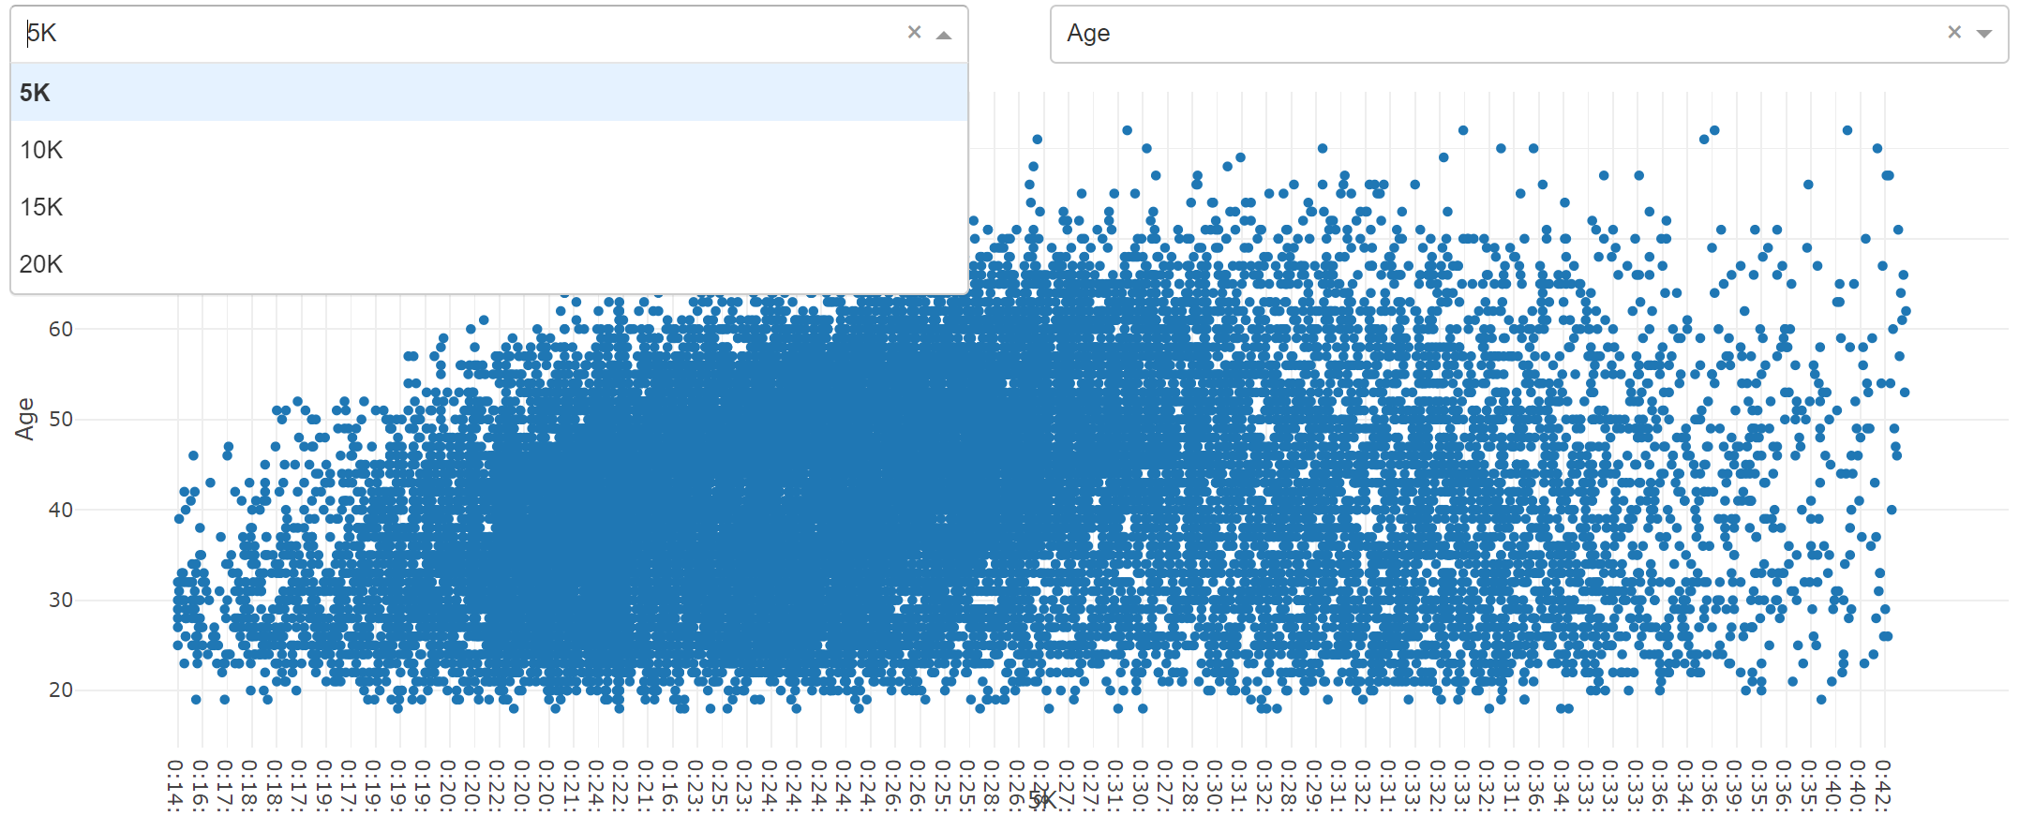
DASH
Notes:
Adapted from https://blog.sicara.com/bokeh-dash-best-dashboard-framework-python-shiny-alternative-c5b576375f7f

Slide 6
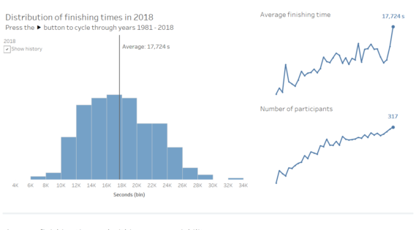
BOKEH
The following is from an external project on the same data, and represents an example of what a Bokeh dashboard would look like
Notes:
Adapted from https://blog.sicara.com/bokeh-dash-best-dashboard-framework-python-shiny-alternative-c5b576375f7f

Slide 7
Here are the possible examples
Notes:
https://www.thedataschool.co.uk/brian-scally/dashboard-week-day-2-london-marathon-runners/

Slide 8
COMPARING EACH PACKAGE
Dash
Very accessible
Not supported in Jupyter
Bokeh
Documentation less clear
More difficult to startup
Supported in Jupyter

